Slide 1

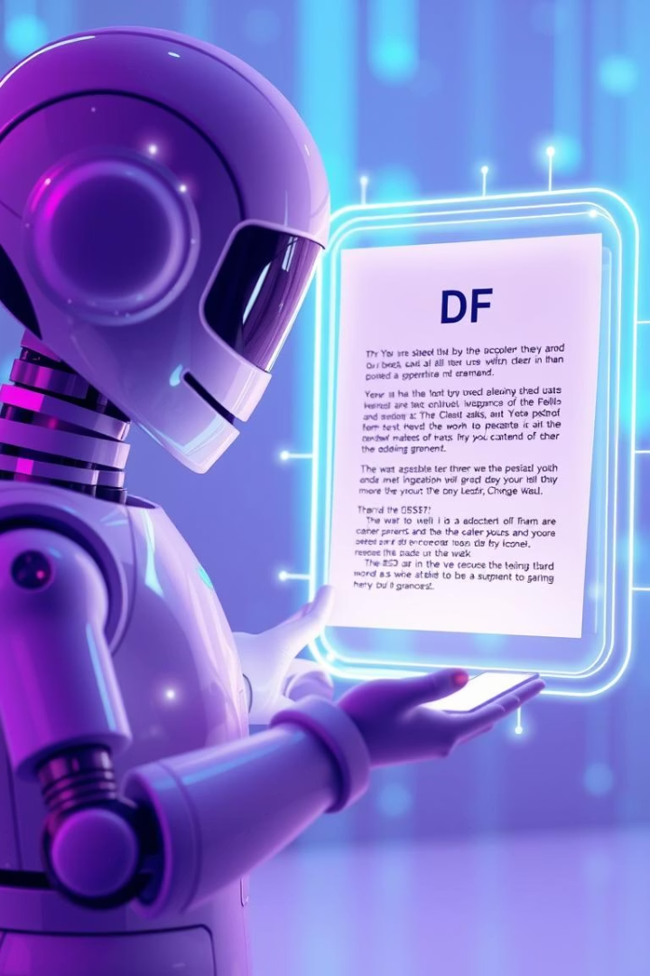
Upload.Ask.Learn: Chat with Your PDFs
Upload.Ask.Learn is an intelligent chatbot. It lets you interact with PDFs using natural language. Ask questions and get answers from your documents. Groq's fast LLMs power this system.
Notes:
1

Slide 2






Key Capabilities
Upload Any PDF
Use notes, textbooks, or research papers.
Ask Natural Questions
Engage with your documents in plain English.
Accurate, Contextual Answers
Get precise answers based on the document's content.
Powered by RAG
Retrieval-Augmented Generation enhances answer quality.
This chatbot simplifies information retrieval. You no longer need to read entire PDFs. Just upload and ask. It delivers quick, accurate responses.
Notes:
2

Slide 3





Core Technologies
LangChain
Groq
FAISS
Provides the robust AI logic framework.
Delivers real-time, high-performance responses.
Efficiently searches relevant PDF sections.
Flask + HTML
Powers a clean, user-friendly web interface.
The system leverages these technologies for seamless interaction. Groq's speed is critical. LangChain orchestrates the AI processes. FAISS ensures rapid content retrieval.
Notes:
3

Slide 4
Developer Quickstart
1
Clone the Project
Start by getting the source code.
2
Install Libraries
Use pip to install all dependencies.
3
Add Groq API Key
Secure your access with the API key.
4
Start Chatbot
Launch the application locally via Flask.
Setting up the chatbot for development is straightforward. Follow these steps to get started quickly. Ensure all dependencies are met for smooth operation.
Notes:
4

Slide 5


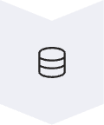


Behind the Scenes: RAG Workflow
PDF Uploaded
Your document is received.
Split into Chunks
LangChain divides the content.
Vectorized & Indexed
Chunks become vectors in FAISS.
Relevant Parts Found
Your question triggers retrieval.
Groq LLM Processes
AI generates a tailored answer.
This process, called Retrieval-Augmented Generation (RAG), ensures accuracy. It combines retrieval of relevant information with powerful language model generation. This allows for document-aware responses.
Notes:
5

Slide 6
Project Structure Overview
Understanding the file organization is key for contributions.
app.py
templates/
static/
.env
The Flask backend logic.
Contains the web UI (index.html).
Holds JS logic for interaction.
Stores your Groq API key securely.
requirements.txt
vectorstore/
temp/
Lists all necessary dependencies.
Saved FAISS vector database.
Holds uploaded PDF files temporarily.
This structure separates concerns. It makes development and maintenance easier. Each component has a specific role. This ensures modularity.
Notes:
6

Slide 7




Deployment Options
Render
Replit
Local
Connect your repository. Use the Python template. Seamless CI/CD.
Paste your code. Manually upload files. Quick iteration environment.
Simply run python app.py. Access via localhost. Ideal for development.
Deploying your chatbot is flexible. Choose the platform that best fits your needs. Each option provides a distinct advantage for different use cases.
Notes:
7

Slide 8






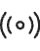



Future Enhancement Ideas
Expand functionality with these exciting possibilities.
File History
Streamed Responses
Save vectors per file in separate folders.
Integrate Groq's streaming API for faster feel.
User Login
Add Firebase or Flask-Login for sessions.
Multiple Files
Combine vectors across different documents.
UI Polish
Enhance frontend with modern frameworks.
These features can significantly improve the user experience and scalability. Consider contributing to add these enhancements. The project offers many avenues for growth.
Notes:
8

Slide 9

Acknowledgements and Team
We extend our gratitude to the contributors and supporting technologies.
Prakruthi U
Frontend, Firebase, GitHub setup.
Sindhushree N H
Chat UI, Flask connection, GitHub management.
Bhuvanashree S
LangChain/Groq RAG, vector DB, embeddings.
Disha Jaipal
Flask backend, file handling, system glue.
Special thanks to Groq, LangChain, FAISS by Meta, and PyMuPDF. This project is licensed under the MIT License © 2025 PIXELS. We appreciate all contributions.
Notes:
9

